Slide 1
An evaluation of lncRNA cell-type expression and the development of functional prediction tools
An informal discussion
Adam Wespiser
July 23, 2013

Slide 2
Overview
What is lncRNA?
Why do we care?
How I approach the problem:
Characterize lncRNA cell-type expression
Find functional lncRNA in the literature
Train classifiers

Slide 3
The data
LncRNA transcripts are from Derrien 2012/Gencode V7
Long-poly-A and long-nonpoly-A whole cell RNA expression
Gene Expression for lncRNA determined as maximum expressed transcript in each cell-type

Slide 4
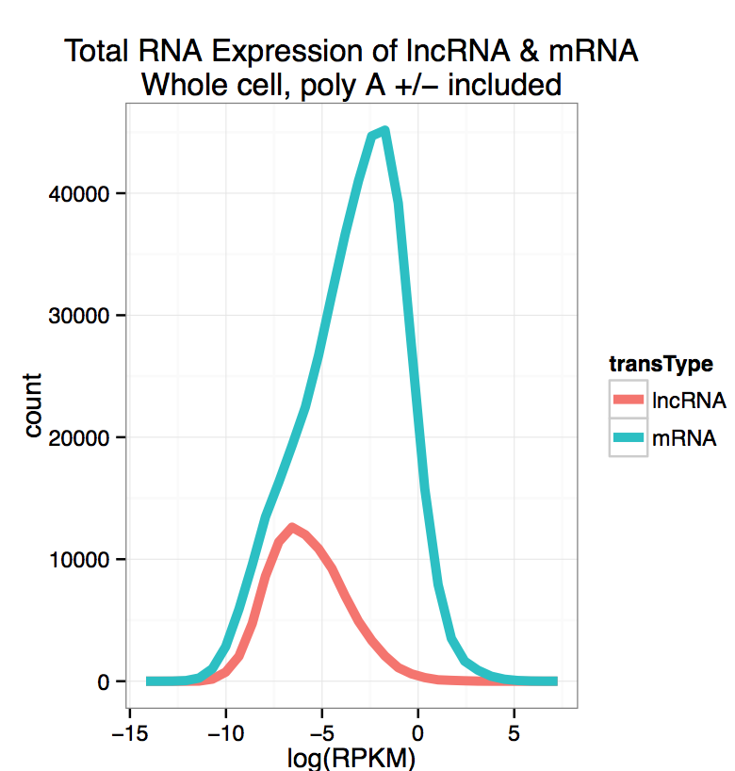
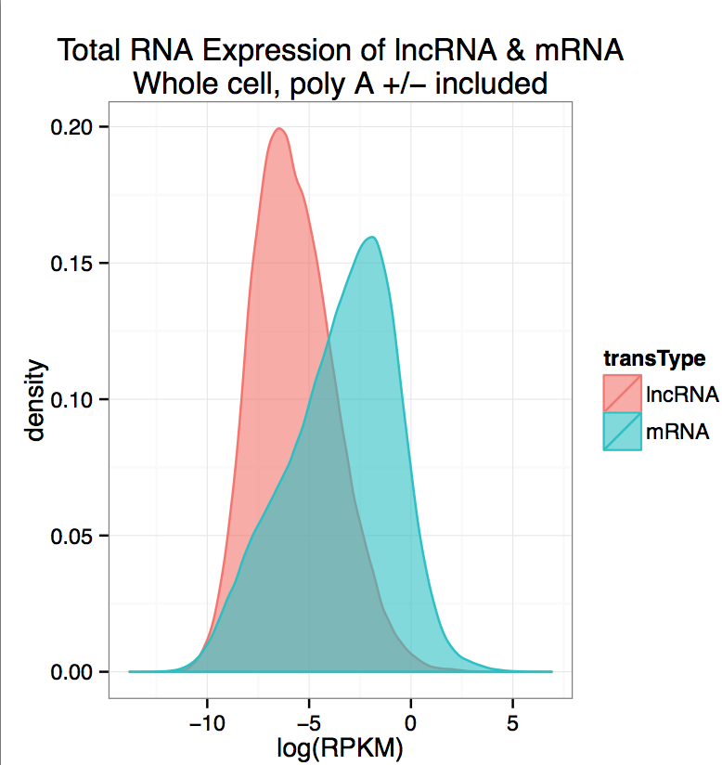
LncRNA have lower expression than mRNA

Slide 5
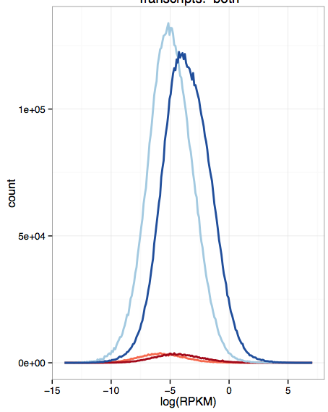
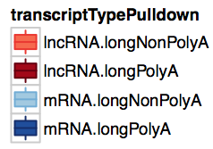
LncRNA tend to be poly-adenylated
Frequency of RPKM of polyA +/- for lncRNA and mRNA

Slide 6
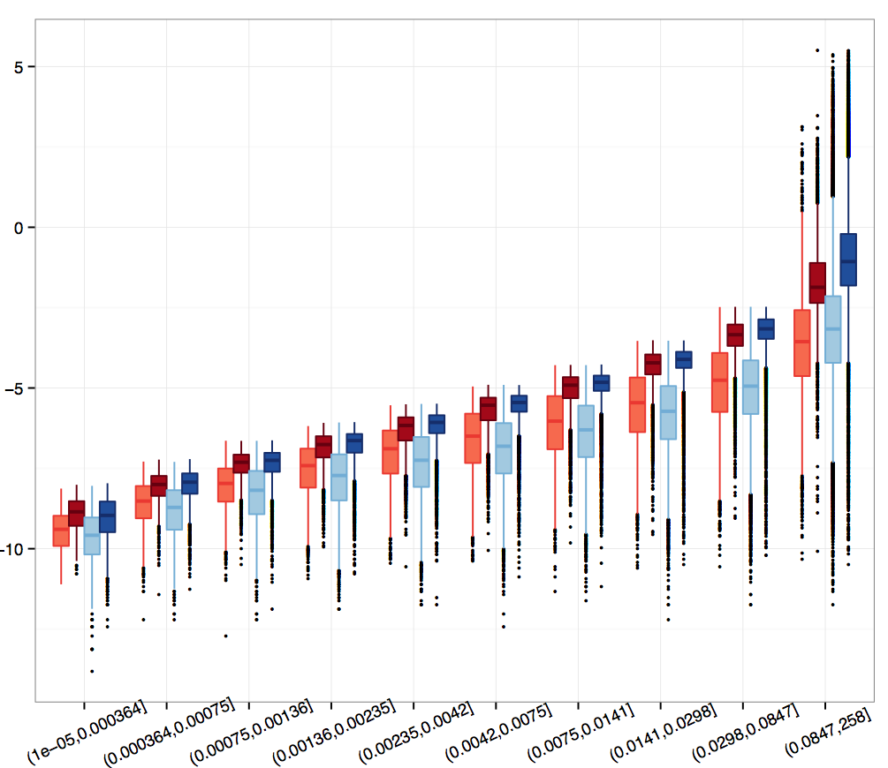
LncRNA at all expression levels tend to be more poly adenylated
Log(RPKM)
RPKM bins (in ascending order)

Slide 7
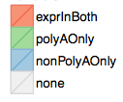
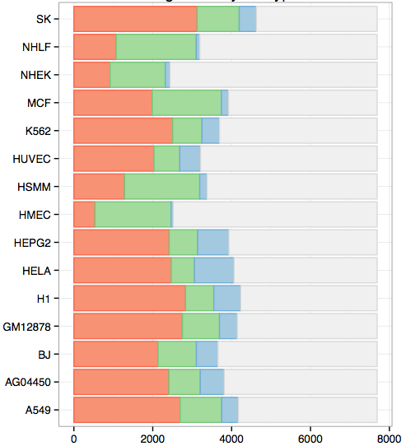
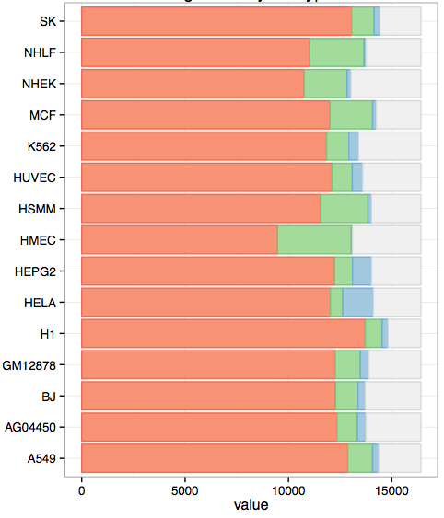
For each cell-type, the number of genes with detected in poly-A, non-poly-A or both RNA-seq pulldowns
LncRNA
mRNA
Count lncRNA (1 – 8000)
Count mRNA (1 – 15,000)

Slide 8
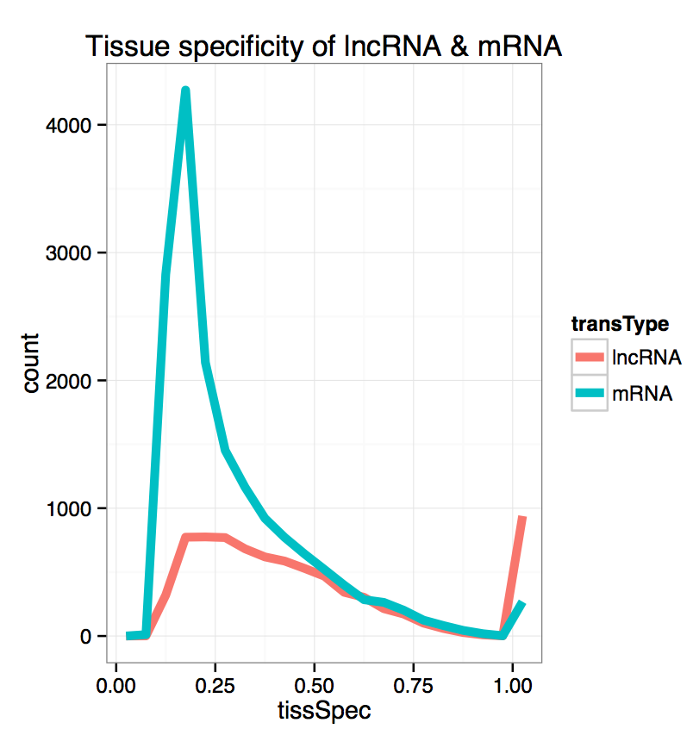
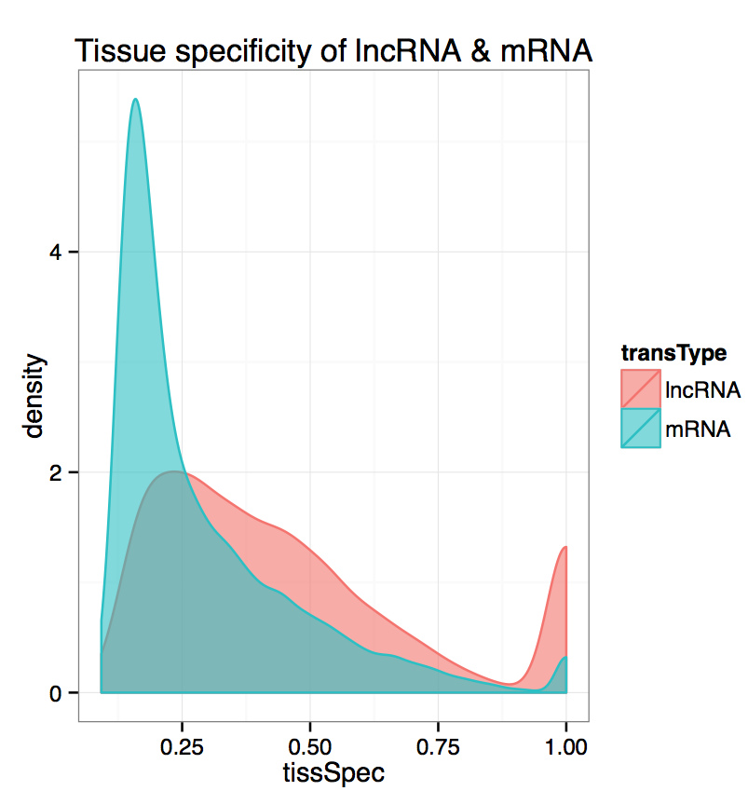
Tissue Specificity of lncRNA

Slide 9
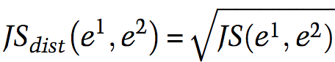
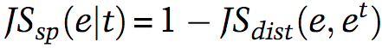
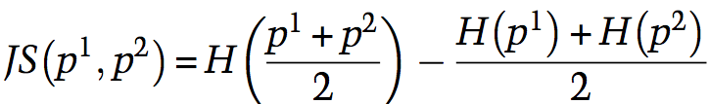
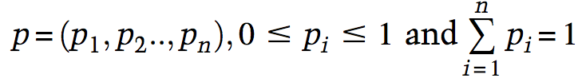
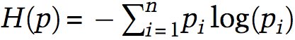
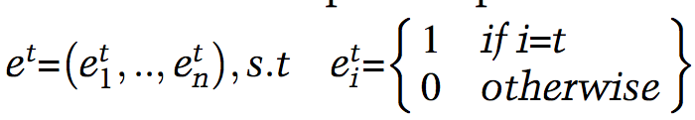
JS_{sp}(e) is Tissue Specificity,
Which can be thought of as the Jensen Shannon Divergence between a lncRNA expression vector and an test expression vector with complete cell-type specificity.
Scaling:
0 < JS < 1
1 = max specificity,
0 = no specificity
JS Divergence
p¹ is expression vector
p² is e^{t}, completely specific to a cell type
*
Helper Functions
H(p) is entropy
t = 2, e^{t} = {0,1,…,0}

Slide 10
Determination of functional lncRNA
LncRNA websites & databases
discard
no
Found within GENCODE V7 & Derrien 2012?
Convert lncRNA identifier to Ensembl gene id
“functional” list of LncRNA
94 found
yes
Examples:
H19
XIST
HOTAIR
JPX
MALAT1
TUG1 + many more…
PUBMED literature search.

Slide 11
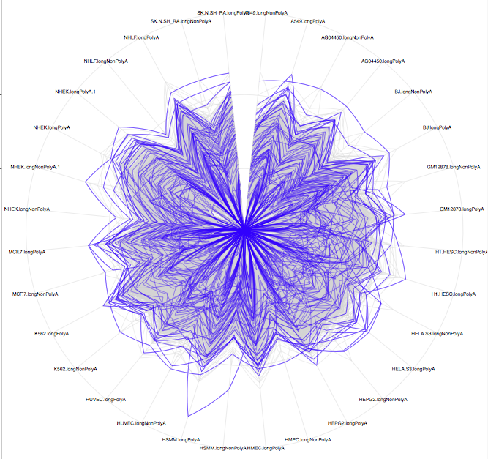
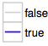
Global view of lncRNA expression: Are functional lncRNA different?
Radial Axis: RNA expression in cell type
lncRNA within functional subset?

Slide 12
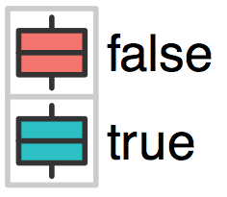
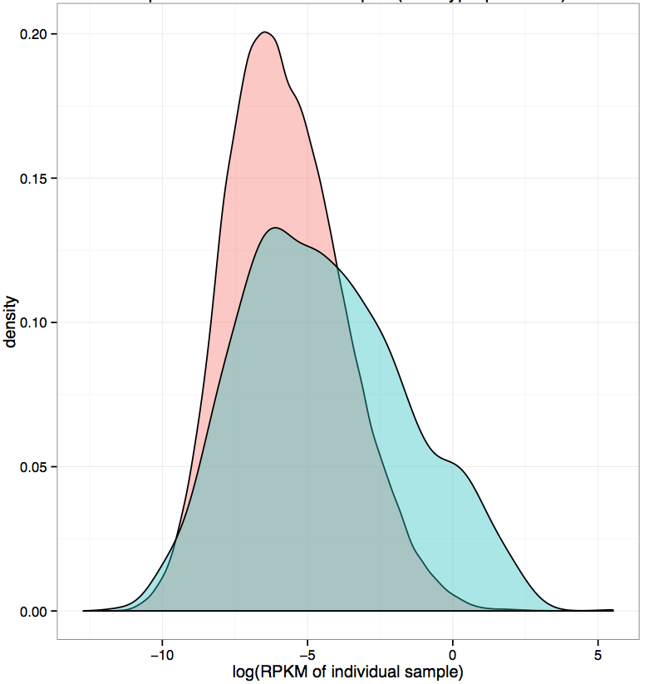
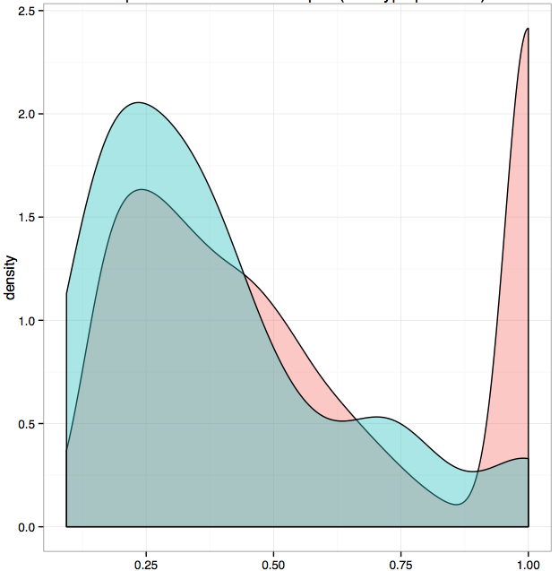
lncRNA tissue specificity all experiments combined
Functional LncRNA?
functional vs. unlabeled lncRNA:
Expression and cell-type specificity
lncRNA expression levels all experiments combined
log( RPMK )
Tissue Specificity

Slide 13
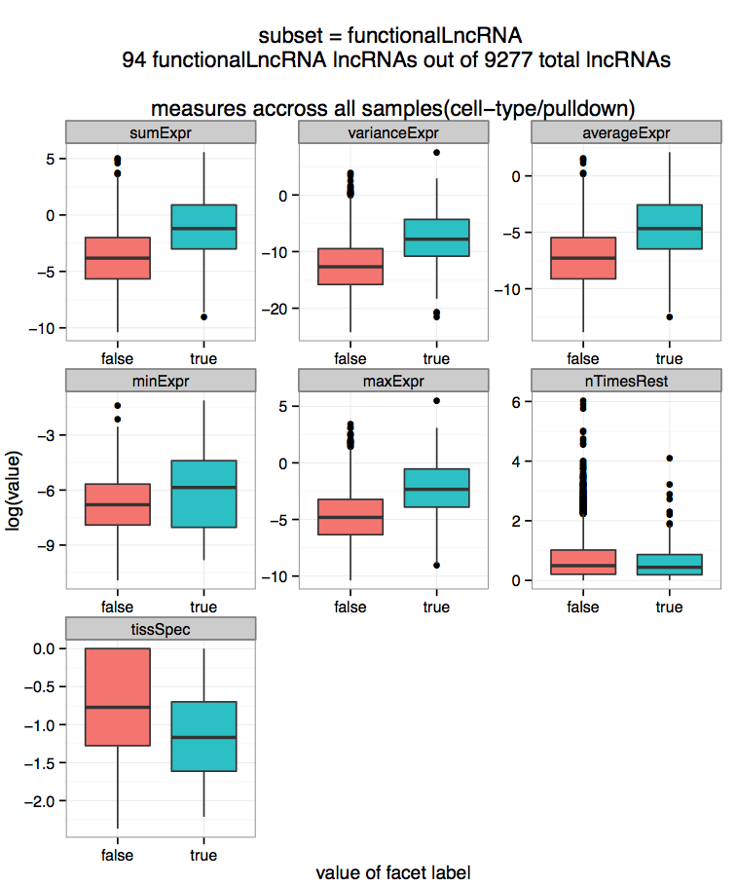

LncRNA expression statistics
Functional LncRNA?

Slide 14
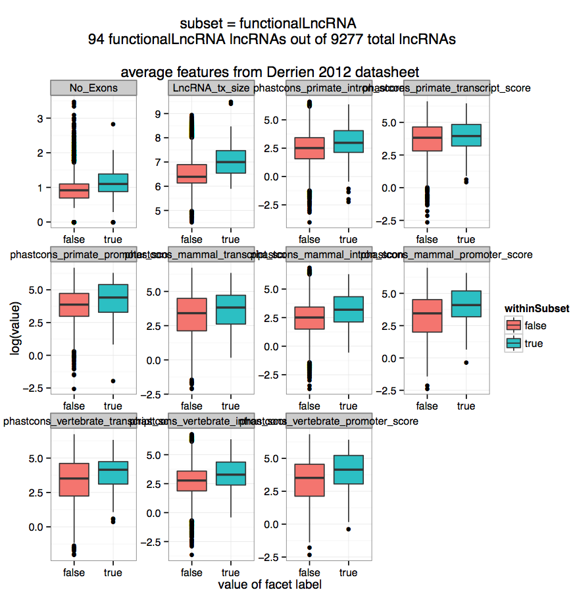

LncRNA transcript features
Functional LncRNA?
R -> L: Primate promoter, mammal transcript,
mammal intron, mammal promoter. (Phastcon score)
R -> L: Vertebrate transcript, vertebrate intro,
vertabrate promoter. (Phastcon score)

Slide 15
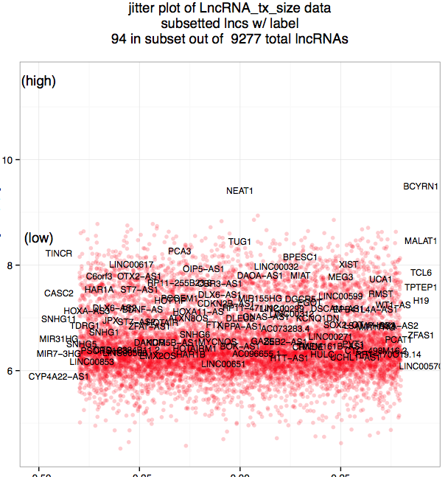
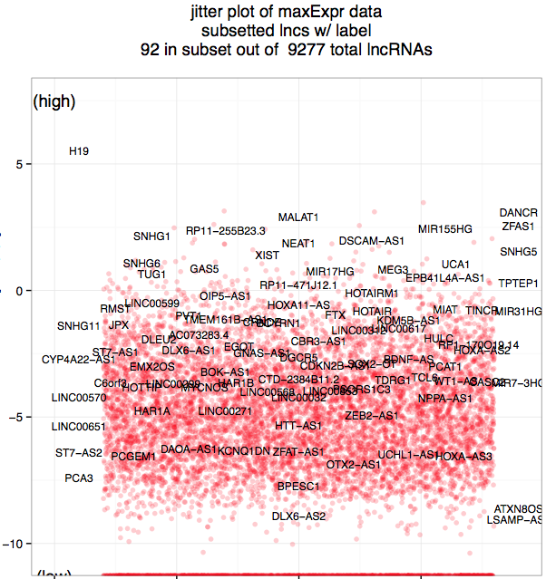
Where are the functional lncRNA?
LncRNA Transcript Size
LncRNA maximum expression over all experiments
Log(max(RPKM))
Log(Transcript Size)
dummy variable
dummy variable
Notes:
Next: p-values

Slide 16
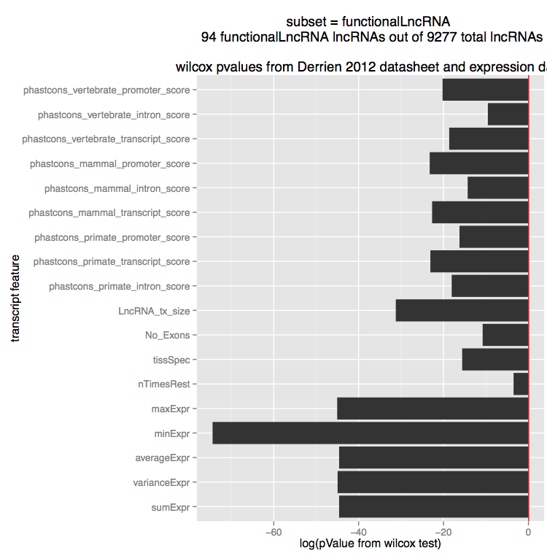

Slide 17
Functional lncRNA findings:
There is a significant difference in a number of metrics.
Transcript Size
Expression
Tissue Specificity
Others?

Slide 18
So there looks to be a difference for some features of lncRNA, what next?
Determine which unlabeled lncRNA are functional
Instance unlabeled learning problem:
Want to solve for p(y = 1 | s = 0 , x, I)
Ratio of labeled to unlabeled is 1/100
PCA
Train classifier in a subspace of lower dimension
pageRank
How close are unlabeled lncRNA to functional lncRNA in expression space?

Slide 19
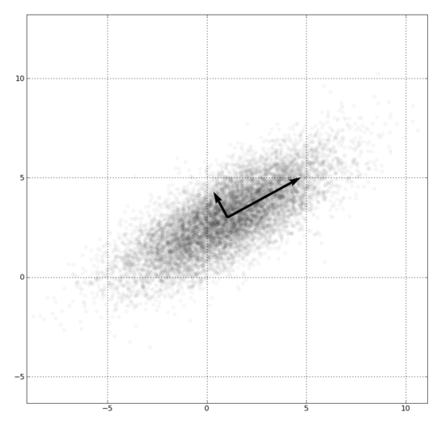
PCA: Principal Component Analysis
Objective: Given a dataset in multiple dimension, find a new series of coordinates such that variance is maximized along the axis.
y
x
Utility:
- Dimensional reduction
- find consistent basis for potentially rotated data. Ex. PDB, image recognition
- better understand your data’s multidimensional variance
Component 1 = x + y
Component 2 = x + -y
https://en.wikipedia.org/wiki/File:GaussianScatterPCA.png

Slide 20
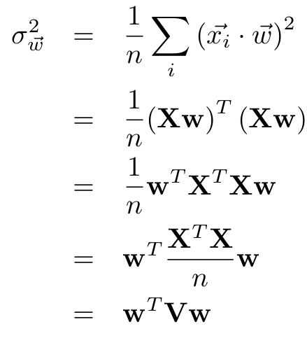
Analysis of PCA: what’s the variance of a projection?
Let X be an (n x p) data matrix with n entries, each of dimension p, with 0 mean.
Let w be a (n x 1) vector s.t. Xw is a projection of X.
Now, calculate the variance of Xw:
(Xw)^{T} = w^{T}X^{T}
(Definition of covariance matrix)
Maximize variance be picking the best w
http://www.stat.cmu.edu/~cshalizi/490/pca/pca-handout.pdf

Slide 21
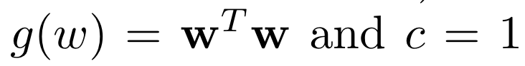
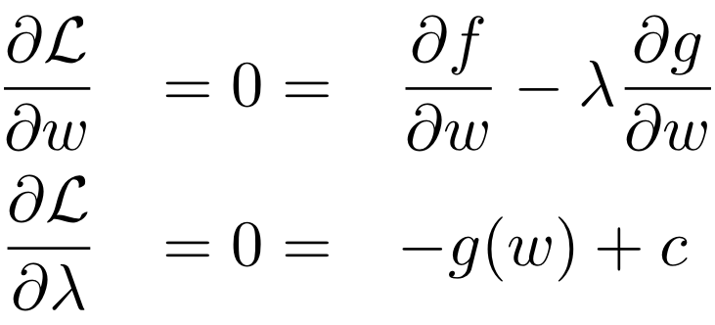
So now that we have an expression of variance in terms of the covariance matrix V, and the projection vector w, we must optimize it. Recall:
Find w to maximize x^{T}Vx
That can be solved for w under the following conditions:
http://www.stat.cmu.edu/~cshalizi/490/pca/pca-handout.pdf

Slide 22
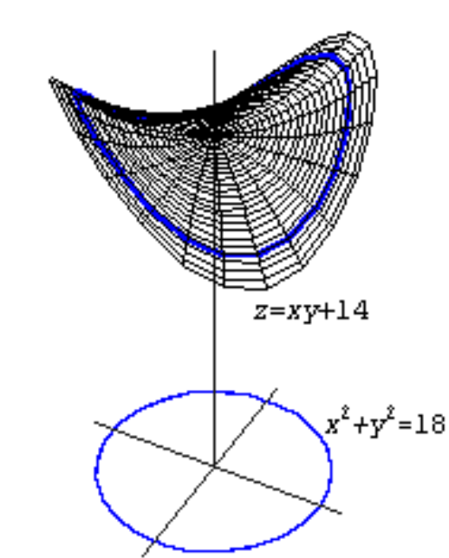
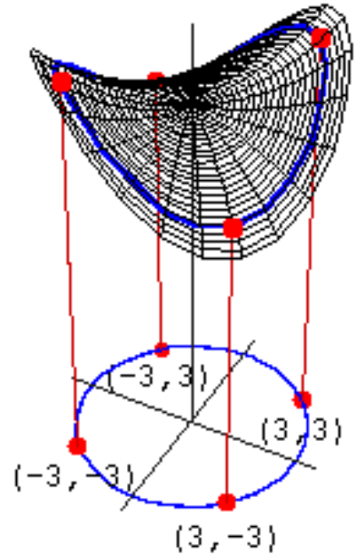
Lagrange Form Intuition:
Variance of X projected by w
constraint on w
http://math.etsu.edu/multicalc/prealpha/Chap2/Chap2-9/printversion.pdf

Slide 23
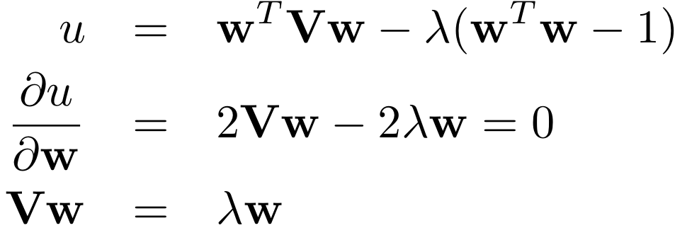
Plugging in our definitions of f(x) and g(x) into the Lagrange identity we are left with the following realization:
The solution that maximizes lambda corresponds to the largest eigenvalue. Therefore, the w that corresponds to a projection of X onto w with maximum variance is the first eigenvector of the covariance matrix V.
http://www.stat.cmu.edu/~cshalizi/490/pca/pca-handout.pdf

Slide 24
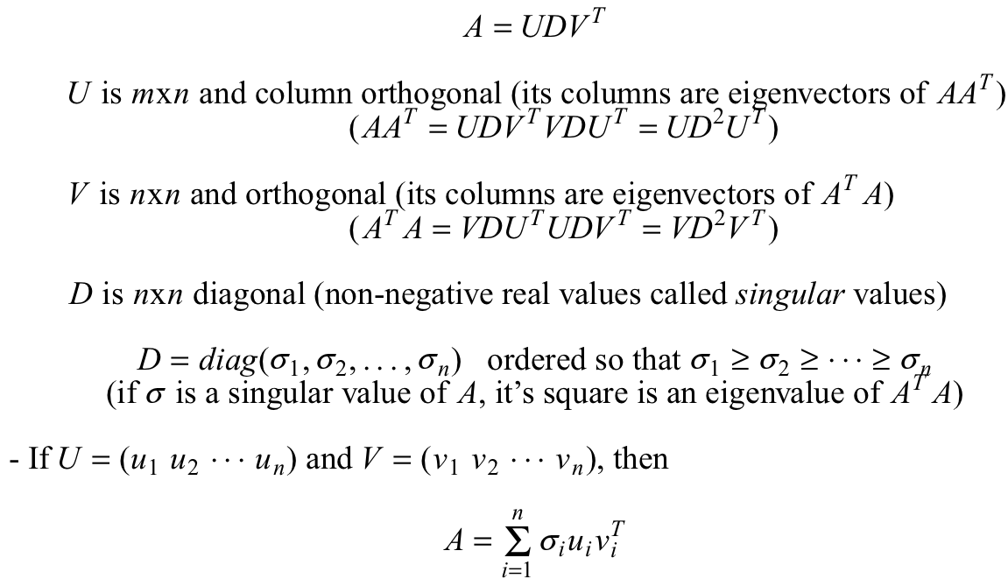
How to find eigenvectors? Use singular value decomposition!
http://www.cse.unr.edu/~bebis/CS791E/Notes/SVD.pdf

Slide 25
PCA overview
We want the projection of X with the most variance
Lagrange multipliers decompose problem
Find first eigenvector of the the covariance matrix using SVD

Slide 26
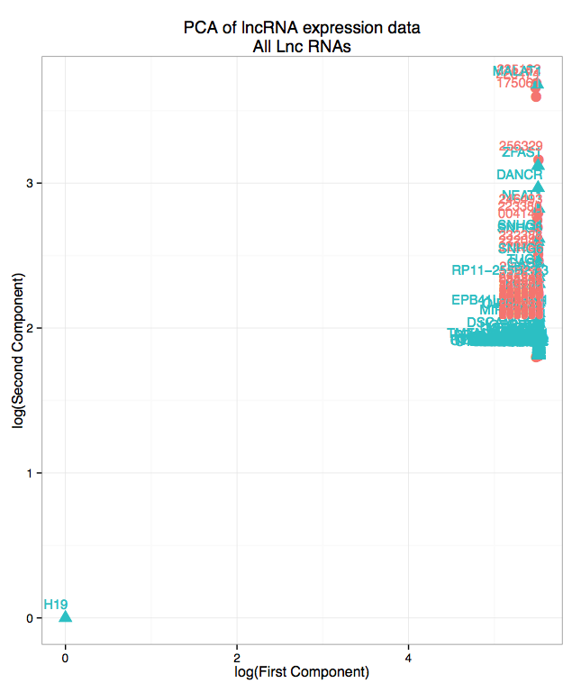
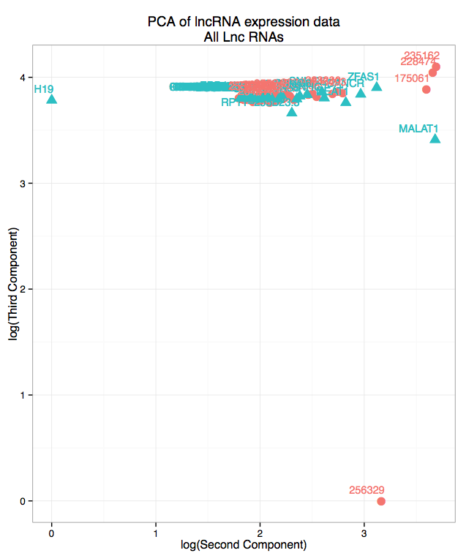
PCA on lncRNA expression

Slide 27
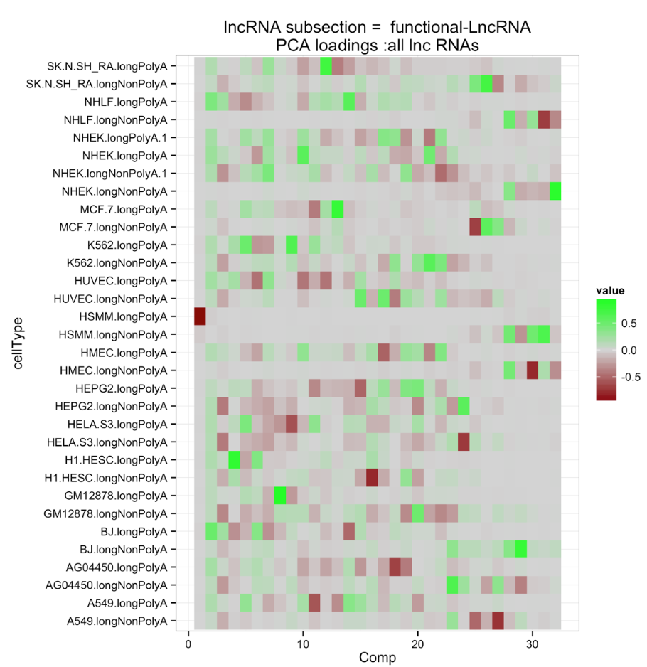
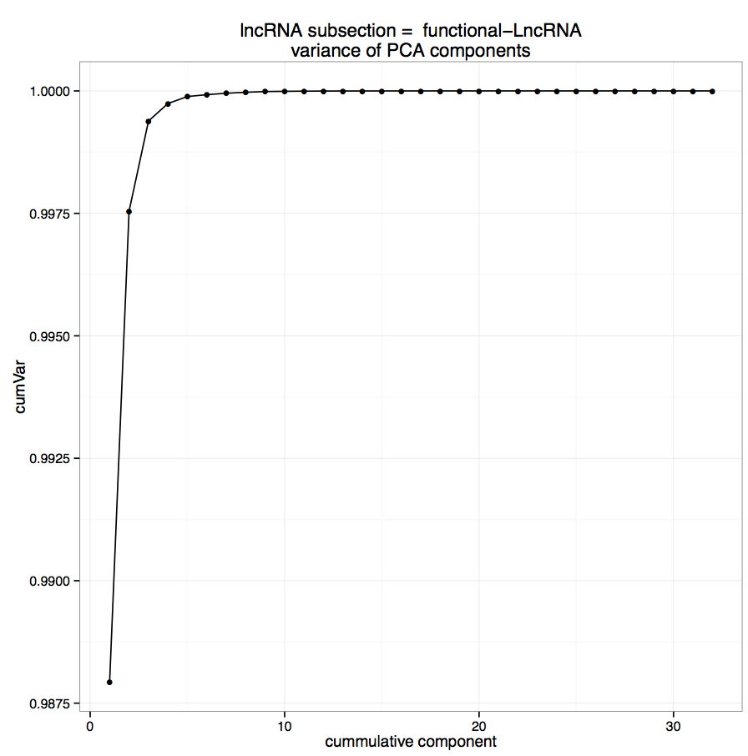
1.000
0.9857
cumulative variance of components
components
Thus, the first component contains > 98% of the variance and is a
vector along one axis.
This is not a good, and we need a solution…

Slide 28
PCA w/o outliers:
Plot PCA with full data -> find outliers ex. H19
Remove outliers -> eigenvectors of the covariance matrix
Project full data with eigenvectors from data w/o outliers

Slide 29
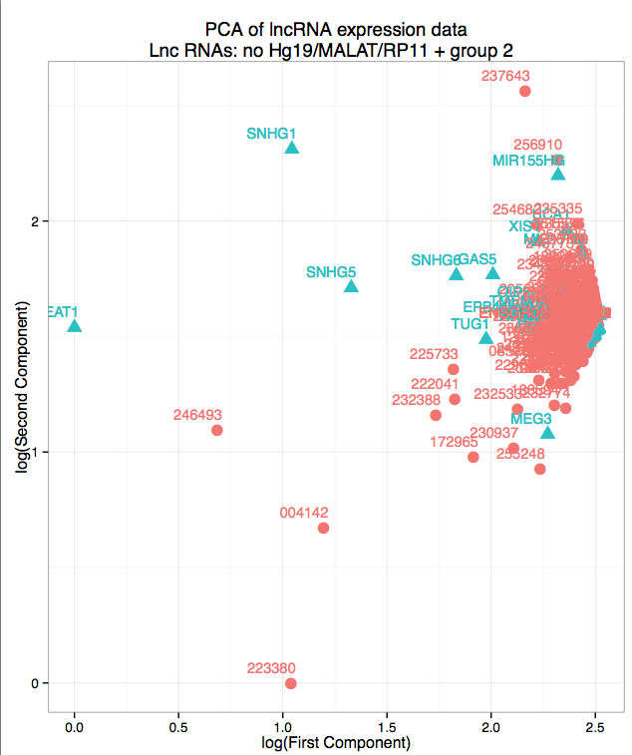
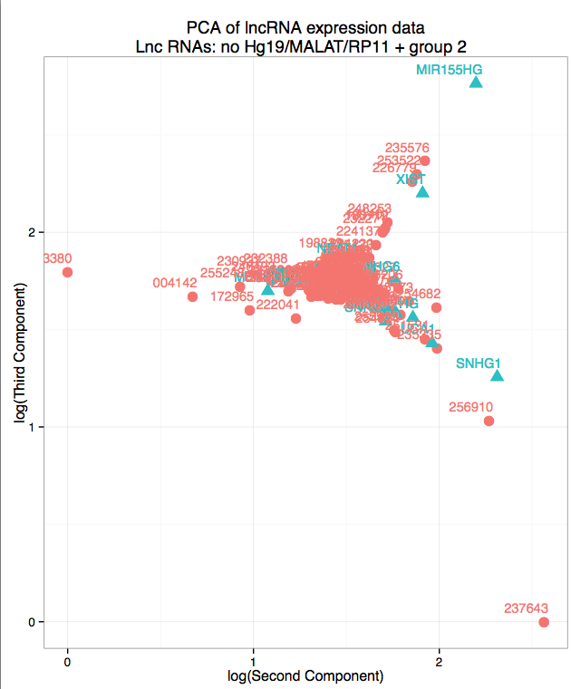
PCA w/o outliers:
Strategy: By eye, remove outliers from first, second and third components in two subsequent rounds.

Slide 30
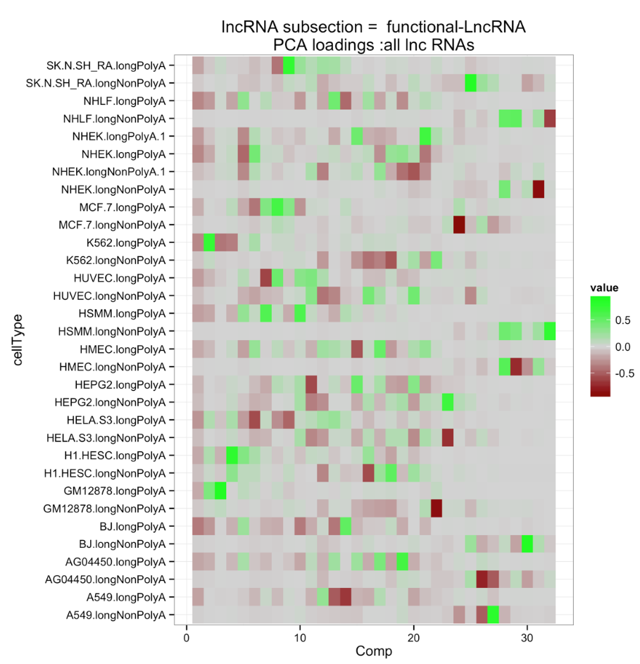
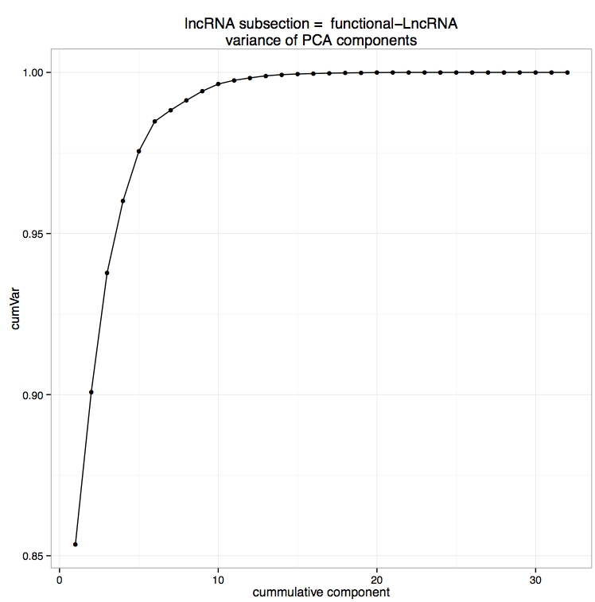
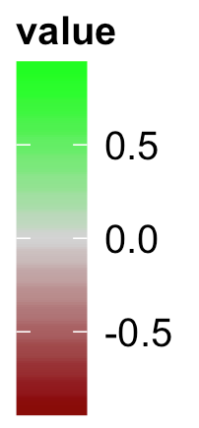
1.00
0.85
component
cumulative variance of components

Slide 31
What is the distribution of function vs. non-functional lncRNA in expression space?

Slide 32
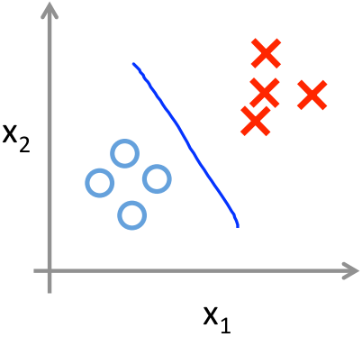
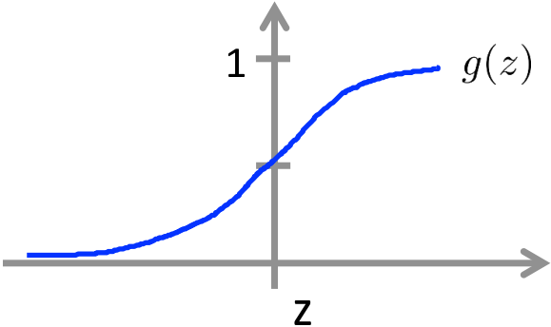
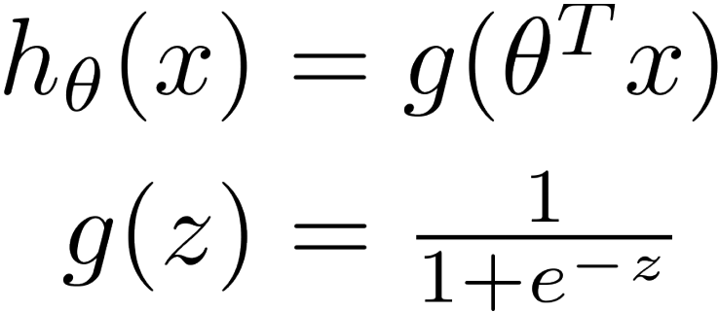
Logistic Regression
Objective: Find the boundary between two data classes, y = 1 & y = 0 for a data vector x, parameterized by θ
For example: if y = 1, then h_{θ}(x) = 1 if the classifier properly works.
This can easily be done by finding θ where θ^{T}x is very large when y = 1, and very small when θ^{T}x is small.
The following equations will give us this ability:
θ^{T}x << 0
g(θ^{T}x) = 0
θ^{T}x >> 0
g(θ^{T}x) = 1
https://d396qusza40orc.cloudfront.net/ml/docs%2Fslides%2FLecture6.pdf

Slide 33
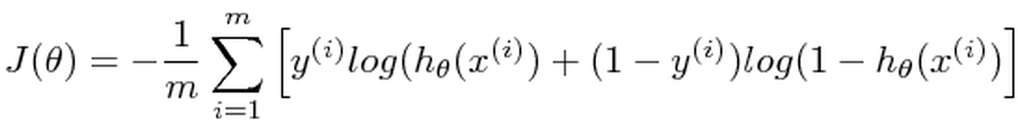
Defining a cost function:
Now that we have a function that to predict y from x, we can define a cost function over all data X as a function of θ given y
Now, we let’s find the gradient of J(θ):
Given the cost function, and its gradient, we can pass them to a computational function minimizer along with X
Example: In octave we can use “fminunc”
In R we can use “optim”
From the optimizer we find a θ, and can use that for predictions
http://feature-space.com/en/post24.html

Slide 34
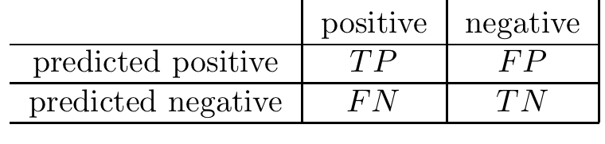
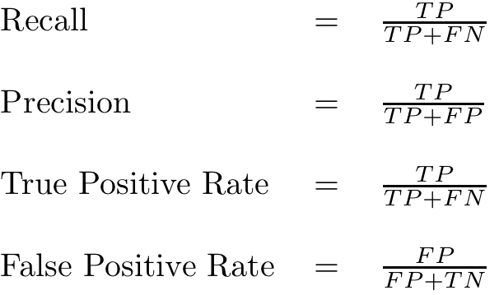
Analyzing a logistic regression classifier
For classifier, we must determine how well it can predict the data.
Let’s say we make a prediction h_{θ}(x), on data X with label y, we can classify each x as the following:
y = 1 y = 0
h_{θ}(x) = 1
h_{θ}(x) = 0
Given these measures for individual data, we can define the following metrics:
https://lirias.kuleuven.be/bitstream/123456789/295592/1/d.

Slide 35
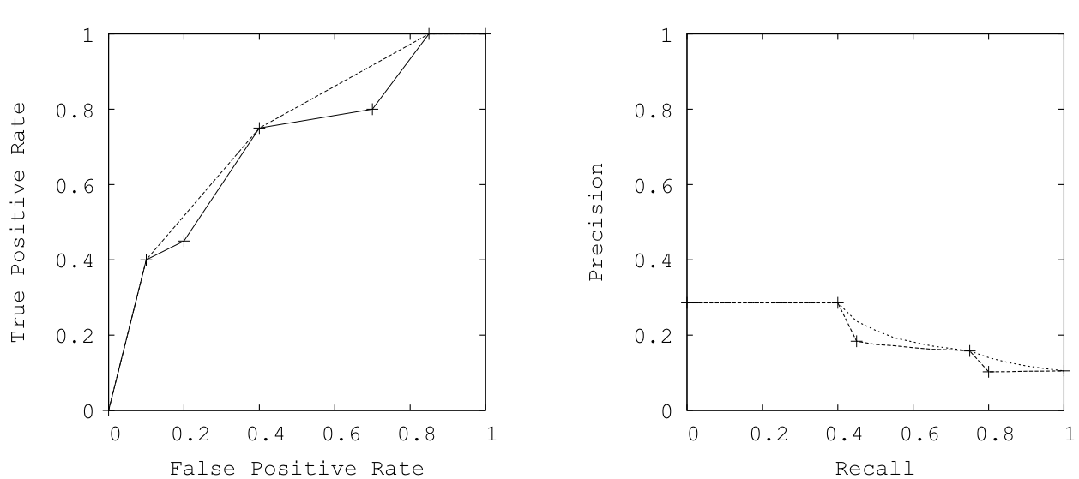
Visualization of logistic regression
ROC Curve:
FPR vs. TPR
PR curve:
precision vs. recall
better
worse
better
worse
Note: These two curves are equivalent
https://lirias.kuleuven.be/bitstream/123456789/295592/1/d.

Slide 36

Logistic regression w/ either a circular or elliptical decision boarder
sens = sensitivity = recall = TP/ ( TP + FN )
prec = precision = TP/ ( TP + FP )
For the ellipse,
Use h_{θ}(x) = g(x^{T}θx)

Slide 37


Slide 38



PageRank: the world’s only $250 billion algorithm
First, we’ll discuss how it applies to the web, then how it can be used for expression data…
The matrix A represents the directed graph.
For node 1, three edges originate it.
Column 1 represent these edges, connecting to nodes 2, 3, 4.
The matrix A has two important qualities: it is positive semidefinite, and column stochastic.
http://www.rose-hulman.edu/~bryan/googleFinalVersionFixed.pdf

Slide 39

For a given page, we can compute its score as the sum of the scores of all pages linking to it.
Thus, we highly rank websites with more links from other well linked sites. Ex. If cnn.com and bbc.co.uk linked to factorbook.org, the ranking of factorbook would increase.
We can express this relationship implicitly as:
Where L_{k} is the set of pages that link to k. (k’s backlinks).
For example, x₁ = x₃ / 1 + x₄ / 2
x₂ = x₁ / 3
x₃ = x₁ / 3 + x₂ / 2 + x₄ / 2
x₄ = x₁ / 3 + x₂ / 2
Which can be re-written as:
Ax = x where x = [x₁ x₂ x₃ x₄]^{T}
http://www.rose-hulman.edu/~bryan/googleFinalVersionFixed.pdf

Slide 40
PageRank has eigenvalue solution:
Ax = x, can be written as Ax = λx,
and now we have an eigenvector problem.
Since A is column stochastic, it follows that A as an eigenvalue of λ= 1, and we can now solve to the equation Ax = x for x.
Definition of rank:
x_{i} = rank for node i when Ax = x
Google’s problem:
Dangling nodes are columns of A with all zeros -> “column substochastic”
Instead of A, M = (1 – m)A + mS , where S has entries of value 1/n, and m ?= 0.15
Application to RNA sequencing data:
Instead of A, we will define a similarity metric: B, using the RNA expression values
Where B_{ij} = inverse distance between expression vector of lncRNA i and j

Slide 41



Slide 42

Each box is subset of data
Containing all functional lncRNA, but only 1/10 of the non-function lncRNA
Functional LncRNA?

Slide 43
Conclusions
In expression space, functional lncRNA are further away from the origin than unlabeled lncRNA.

